Slide 1
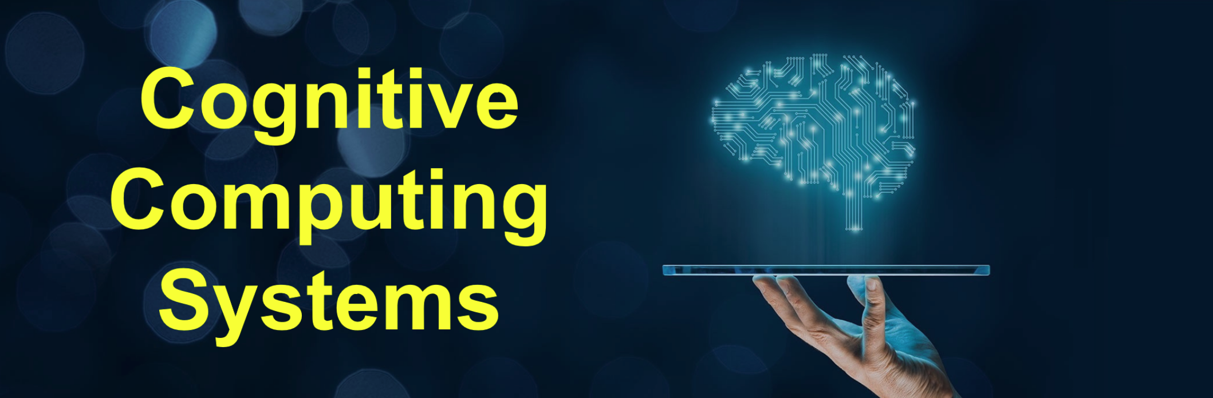
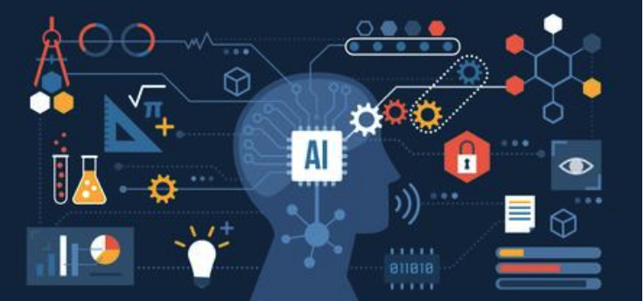
Cognitive Computing Lab
[Sourav Neupane] - 2023 Summer IDP

Slide 2
YSM Achievement
Achievement 1
Machine learning algorithms
Gained knowledge about different popular machine learning algorithms.
Learned to identify patterns and relationships in data that may not be apparent.
Achievement 2
Feature Engineering and Hyperparameter Tuning
Understood the data, extracting relevant features, transforming them appropriately, and selecting the most informative one.
Conducted a systematic search or use optimization techniques to find the best combination of hyperparameters for my model using techniques like grid search.
Achievement 3
Docker and Fast Api Configuration
Acquired skill in containerizing a machine learning model
Grasped knowledge in FastApi to predicts risks.

Slide 3
IDP
Patent Ideas :
Method and System for Risk Prediction in Pacemaker Implantation.
Artificial Intelligence-Based Decision Support System.
Real-time Monitoring and Alert System for Pacemaker Implantation.
Paper/ Patents
Machine learning method for predicting pacemaker implantation following transcatheter aortic valve replacement.
Towards patient-specific prediction of conduction abnormalities induced by transcatheter aortic valve implantation a combined mechanistic modelling and machine learning approach.
Research

Slide 4
Plans for the rest of the year
Plan 1 :
Learning Deep Learning and Federated learning
Becoming proficient in deep learning libraries like TensorFlow, PyTorch, or Keras.
Learn about the architecture and concepts of distributed systems as federated learning involves training machine learning models across multiple devices or edge nodes.
Gain knowledge of the techniques used to aggregate model updates from multiple devices while preserving the global model's accuracy and performance. This includes methods like weighted averaging, ensemble techniques, or federated averaging.
Plan 2 :
Investing time to master Data science core skills
Data Visualization: Exploring innovative visualization techniques to effectively communicate complex patterns and insights from large datasets, facilitating data exploration and decision-making.
Privacy and Security: Skilling myself in the challenges of data privacy, anonymization, secure data sharing, and protecting against adversarial attacks on machine learning models.

Slide 5
Gachon
Cognitive Computing Lab

